Slide 1
Primal Leadership
by Daniel Goleman, Richard Boyatzis and Annie McKee
Lelia King and Tracey Worrell
April 10, 2013
Notes:
authors

Slide 2

Primal Leadership
Lelia’s story: Good intentions
Tracey’s story: Jumping to conclusions
Source: jobjasoos
Notes:
In an exit interview in December, HR director talked about emotional intelligence, or EQ
Leaving for another, better position, but still wanted to share some honest feedback
She asked me, “so why do you think you can get along better with your boss than your colleagues can?”
-Talked to me about how, in general, people have good intentions. If we assume that first, many disagreements seem petty.
-Has encouraged me to rethink my own gut reactions.

Slide 3
Primal Leadership
What is Emotional Intelligence?
  How leaders handle themselves and their relationships
What is Primal Leadership?
  The emotional task of the leader is primal. It is both the original and the most important act of leadership.
  The fundamental task of leaders: prime good feelings in those they lead
  Resonance: driving emotions positively, bringing out the best in your team
Notes:
Tracey

Slide 4

Emotional Intelligence

Slide 5
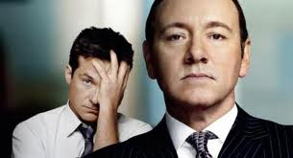
Emotional Intelligence
A basic concept
  Why is it so hard for so many leaders?
  Is it hard for you or for your boss?
Notes:
Lelia
This was a really extreme example, but it brings up a great point. Why is emotional intelligence so simple but so hard for many of our bosses?
Open up for discussion. Why do so many people miss the mark?

Slide 6
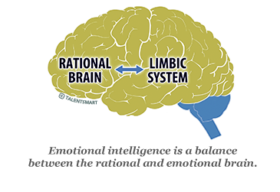
Emotional Intelligence –
It’s All in Your Head!
Source: TalentSmart
Notes:
Lelia
According to the book, it starts with how your brain is programmed.
New findings in brain research show that the neural systems responsible for the intellect and for the emotions are separate, but have intimately interwoven connections
This brain circuitry provides the neural basis of primal leadership.
Although our business culture places great value in an intellect devoid of emotion, our emotions are more powerful than our intellect.
Emotionally intelligent leaders have to train themselves to react to things in a different way.
Anyone can learn to balance this better. This book prescribes several ways to do so, which we will talk about a little later.
The book also talks about the brain as an Open Loop system.
A study at Yale University showed that among working groups, cheerfulness and warmth spread most easily.
Laughter, in particular, demonstrates the power of the open loop in operation.
Unlike other emotional signals which can be feigned, laughter is largely involuntary.

Slide 7
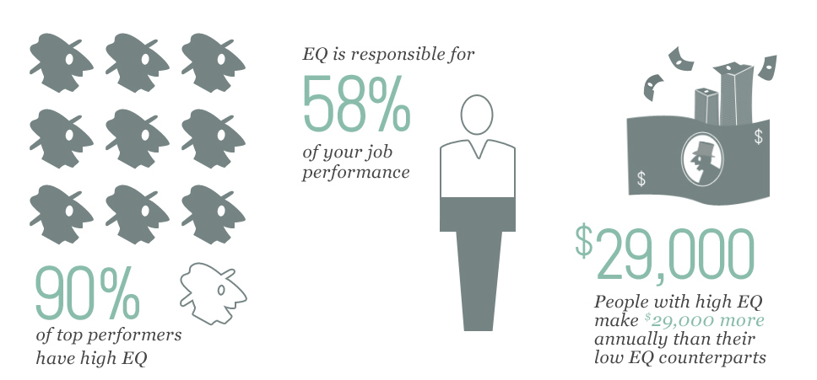
Why is EQ Important?
Source: TalentSmart
Notes:
Tracey – making the point that it affects the bottom line
Employee retention

Slide 8
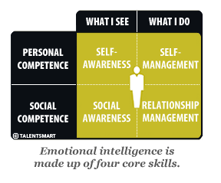
Emotional Intelligence Competencies
Source: TalentSmart
Notes:
Lelia
As I’ve already mentioned, these are not innate talents, but learned abilities (not traits)
Each of these put together make leaders more resonant
Four core competencies of Emotional Intelligence: Self-Awareness, Self-Management, Social Awareness, Relationship Management
As you can see here, these are split into “what I see, what I do…”
Self-awareness
Emotional self-awareness: Reading one’s own emotions and recognizing their impact and using “gut sense” to guide decisions.
Accurate self-assessment: Knowing one’s strengths and limits.
Self-confidence: A sound sense of one’s self-worth and capabilities.
Self-management
Emotional self-control: Keeping disruptive emotions and impulses under control.
Transparency: Displaying honesty, integrity and trustworthiness.
Adaptability: Flexibility in adapting to changing situations or overcoming obstacles.
Achievement: The drive to improve performance to meet inner standards of excellence.
Initiative: Readiness to act and seize opportunities.
Optimism: Seeing the upside in events.
Social Awareness
Empathy: Sensing others’ emotions, understanding their perspective, and taking active interest in their concerns.
Organizational awareness: Reading the currents, decision networks, and politics at the organizational level.
Service: Recognizing and meeting follower, client or customer needs
Relationship Management
Inspirational leadership: Guiding and motivating with a compelling vision.
Influence:Wielding a range of tactics for persuasion.
Developing others: Bolstering others’ abilities through feedback and guidance.
Change catalyst: Initiating, managing and leading in new directions.
Building bonds: Cultivating and maintaining relationship webs.
Teamwork and collaboration: Cooperation and team-building

Slide 9
5 Stages of Discovery
First Discovery: Discovering/Uncovering Your Ideal (a self-awareness exercise)
Second Discovery: Understanding Who You Are Now (dig deeper into self-awareness)
Third Discovery: Designing an Action Plan For Change (self-management of goals)
Fourth Discovery: Changing Your Habits and Behavior (through social self-management)
Fifth Discovery: Success Through Relationship
Notes:
Tracey
This is where the logical part of your brain comes into play, this is where you slow down and THINK. Then put together an action plan, change your behavior, and that will all eventually start to become more natural.

Slide 10
What next?
Resonance vs. Dissonance
  When leaders drive emotions positively we call this effect resonance. When they drive emotions negatively, leaders spawn dissonance, undermining the emotional foundations that let people shine.
Being empathetic ≠ being nice
What factors could stand in the way of this working? Is this approach realistic?
Notes:
Lelia
-Being empathetic doesn’t necessarily mean being nice. It means figuring out what the whole system really needs.
The book focused a lot on building resonance among your team rather than dissonance.
Dissonance, in its original musical sense, describes an unpleasant, harsh sound.
Dissonant leadership produces groups that feel emotionally discordant, in which people have a sense of being continually off-key
Still puts a lot of onus on the leader
Resonant leaders, on the other hand, are attuned to their people’s feelings and move them in a positive emotional direction.
Resonance comes naturally to emotionally intelligent leaders. Their passion and enthusiastic energy resounds throughout the group.
When there are serious concerns, emotionally intelligent (EI) leaders use empathy to attune to the emotional registry of the people they lead
Something we wanted to bring to you is a question about whether this approach is really realistic. Again, sounds nice, but could these “stages of discovery” really help in a situation you might be dealing with? What about your boss?

Slide 11
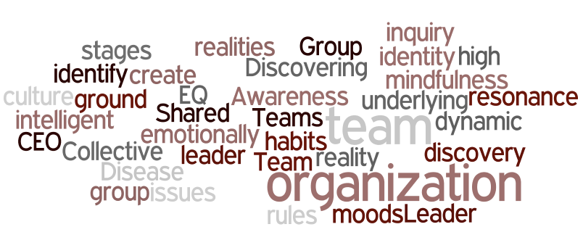
Building Emotionally Intelligent Organizations
Notes:
Tracey
Teams can go through the 5 stages of discovery in order to become a more emotionally intelligent and create resonance
Leader:team as team:organization
Awareness of the realities of the group
Shared moods, habits
Group identity
Collective mindfulness
Team culture
Still needs a leader with high EQ – He/she sets the ground rules
“CEO Disease”
Discovering the organization’s reality through dynamic inquiry – identify underlying issues

Slide 12
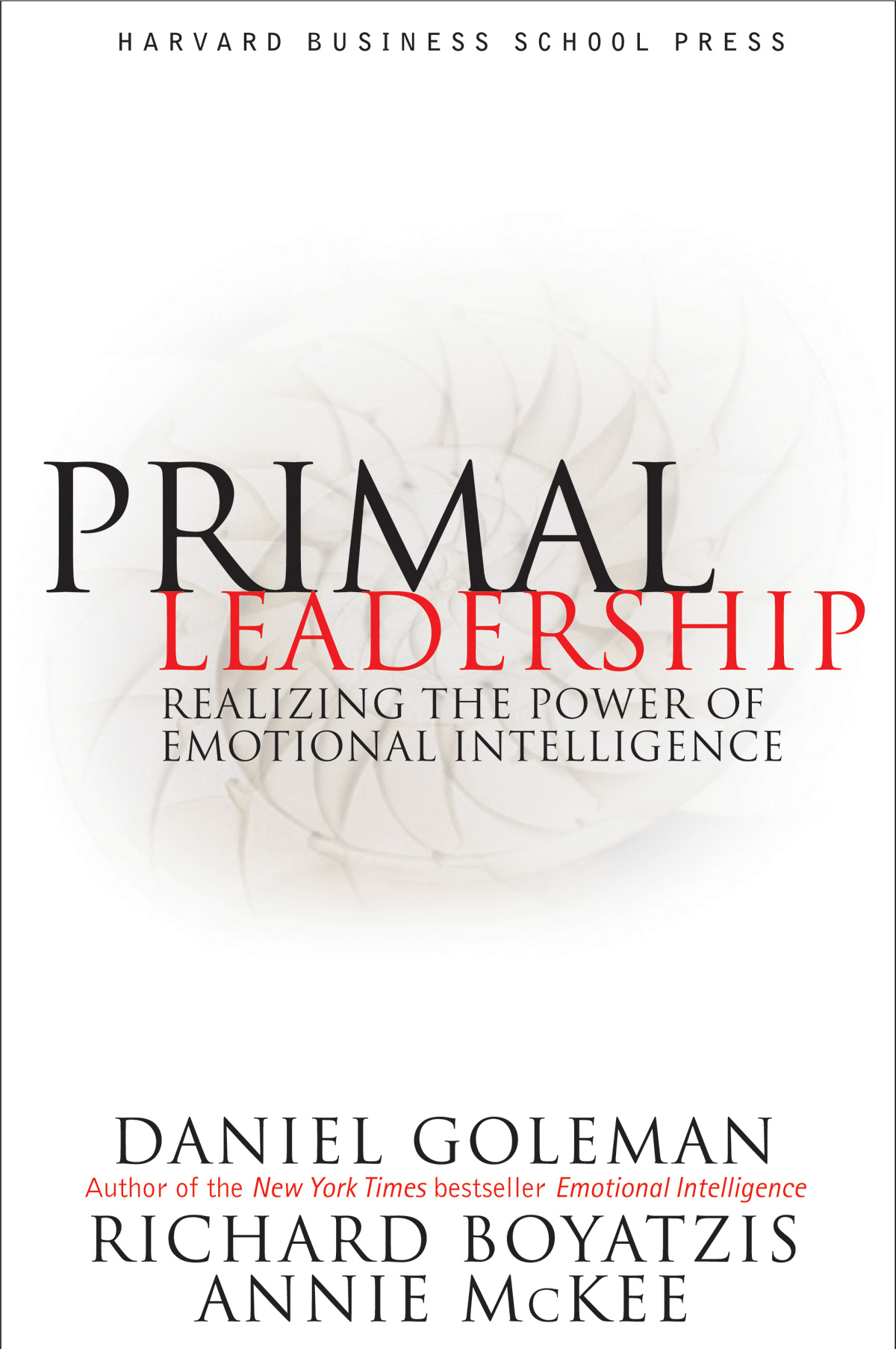
Primal Leadership: Book Critique
Notes:
Pros:
- The book really resonated with me because of my own experience with a boss who I now can see was really lacking in emotional intelligence
- It seems like a touchy-feely subject, but according to the book (p.17), analyses suggest that, overall, the climate - how people feel about working at a company can account for 20 to 30 percent of business performance. And climate is largely based on the actions of the leader. When I look back at my own performance at companies where I wasn't happy, I can see how my feelings about the climate affect what I produce. So, there is a business case to be made for hiring emotionally-intelligent leaders.
- "Self-absorbed leaders can often be clueless." (p.26) Haven't we all experienced this? Ha! But, the book makes good points about self-awareness vs. self-absorption. It's really important to understand the difference.
- Emotionally intelligent leaders are basically really good at balancing personal emotions vs. business consequences. It's a tricky balance, but the book says it can be learned, which is a powerful takeaway.
- "Institutions that endure thrive not because of one leader's charisma, but because they cultivate leadership throughout the system." (p.36) We've heard this thought in some of our other books, and the thread continues here. But I like that this book makes the point that, before you can cultivate others, you have to focus on yourself.
Cons:
- I didn't really need to understand the underlying brain dynamics that cause certain competencies in leaders - it's nice to know, but the book includes a bit much for me.
- It also gets a bit into nature vs. nurture which touches on trait theory, but uses this point to make a case for the fact that anyone who is motivated can learn emotional intelligence. I'm a little skeptical and this is the portion of the book that starts to lose me because it's SO optimistic.
- The book names and briefly explains six leadership styles that emotionally intelligent leaders can use, but this piece is a bit disjointed for me. It doesn't fully connect the dots about what situations call for what types of leadership, and how to really understand when to use which style.

